Slide 1
2018 TSUG Conference
Gradebook Bells &
Whistles for the
Classroom Teacher

Slide 2
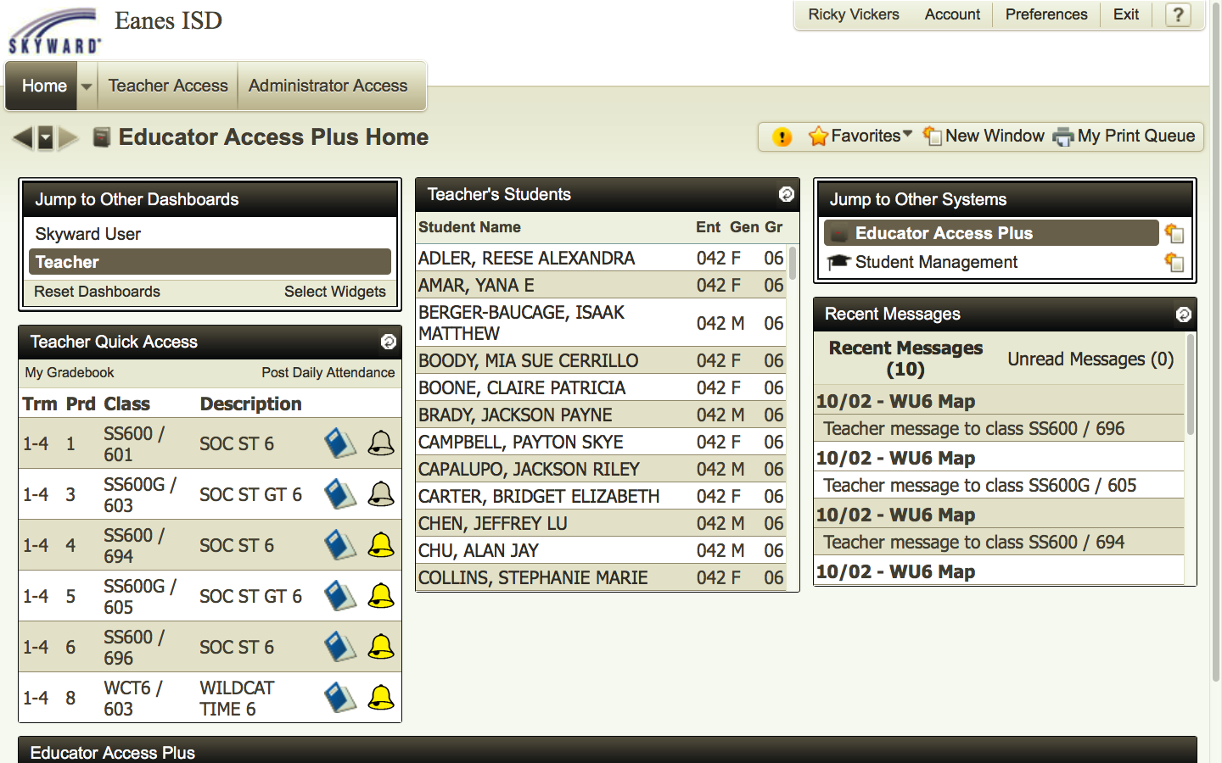
Quick Roll Check!
Open Skyward Gradebook.
2. Click on Yellow Bell.

Slide 3
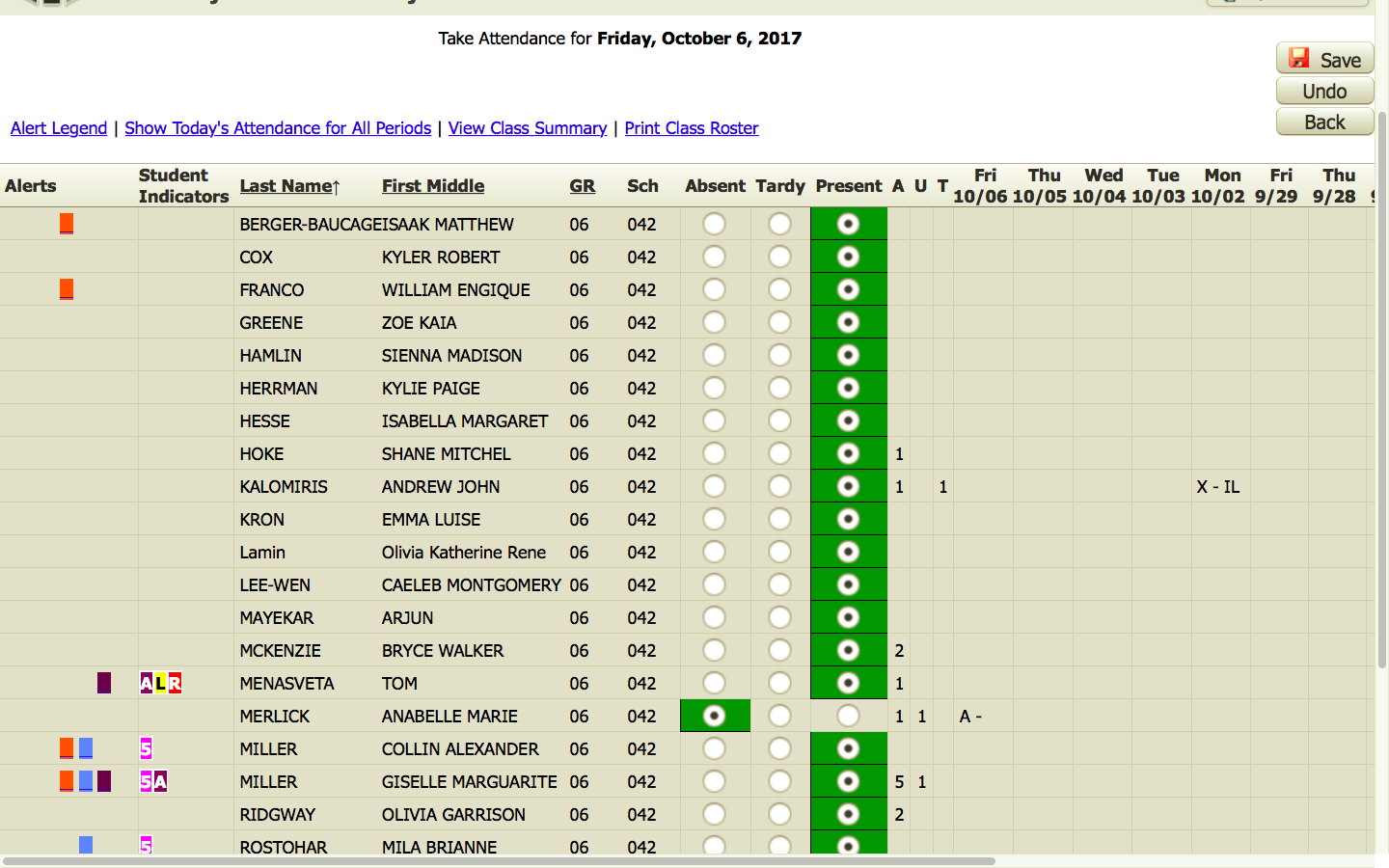
Quick Roll Check!
3. Mark Attendance and
Return to Main Page.

Slide 4
Quick Roll Check!
I hate taking roll!
It is required!
I utilize seating charts to save time!
I use my iPad for roll only and leave it open to expedite roll call.
Easy to update if/when a kid comes in late.
I do update my seating charts!
Sometimes, I have them sit just long enough for roll and then they move.
It is the daily opening routine for my classes and the kids don’t even know what I am doing most of the time!

Slide 5
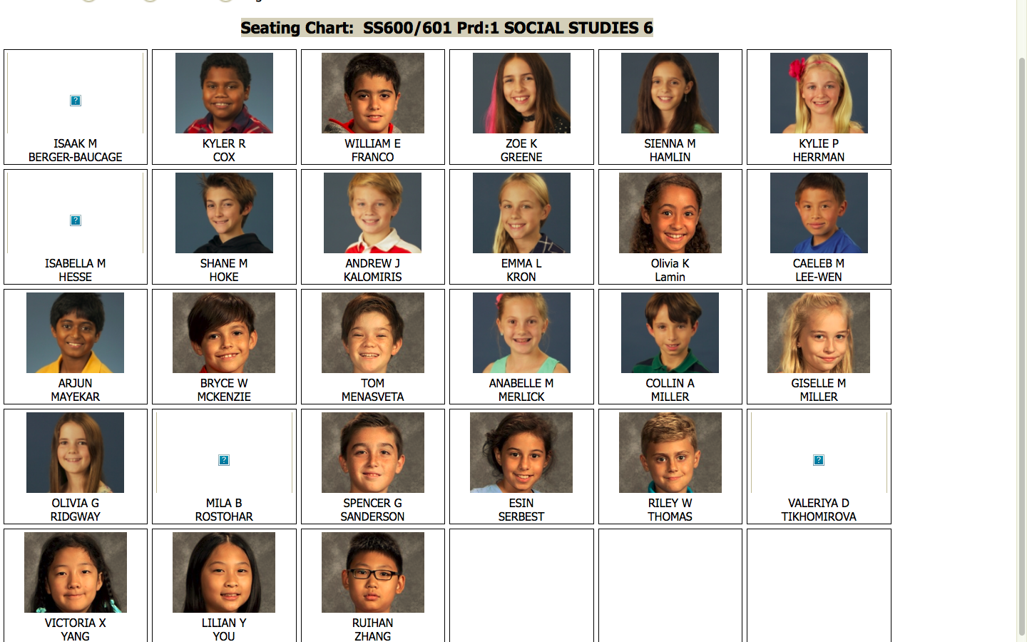
Roll for Substitute – Pictures!

Slide 6
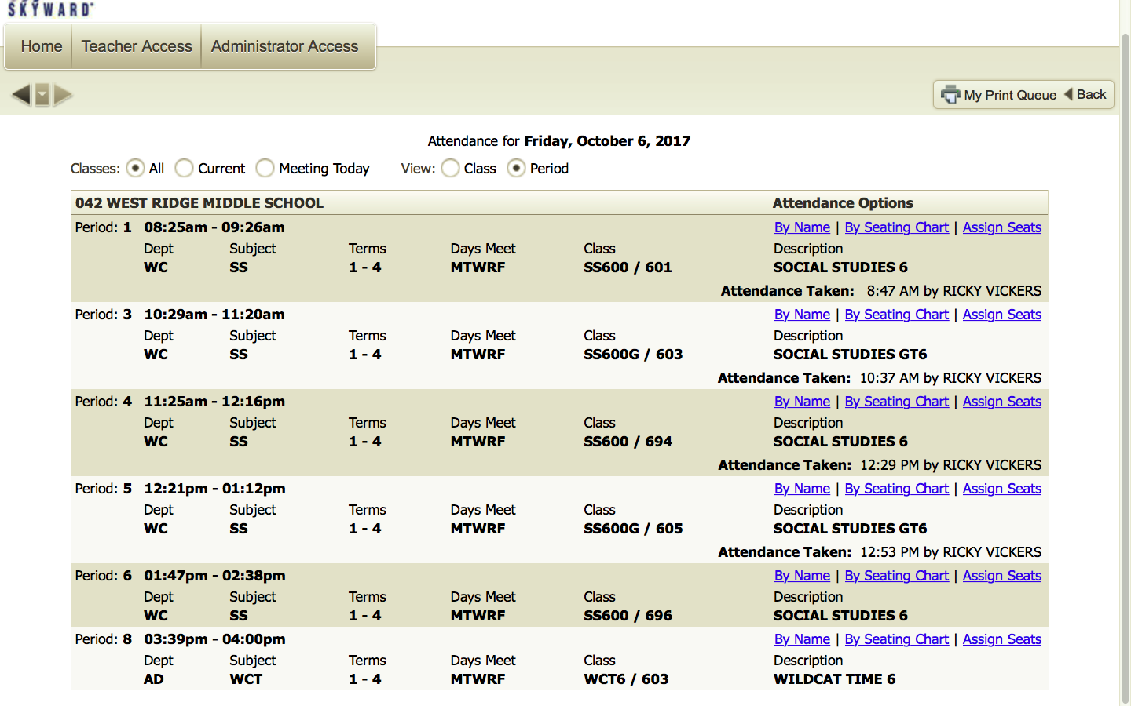
Roll for Substitute – Pictures!
1. After selecting
the “Attendance Bell”
on the home screen, select
By Seating Chart and
this will open
2. Make a copy for your
substitute – they will love you for it!.

Slide 7
Roll for Substitute – Pictures! A Picture can be Worth A Thousand Words in Behavior Expectations

Slide 8
There is a Seating Chart!
1. After selecting
the “Attendance Bell”
on the home
screen, select
Assign Seats to
activate this option

Slide 9
There is a Seating Chart!
2. You will choose select
to move student
3. Then swap with another student
4. Pros/Cons

Slide 10
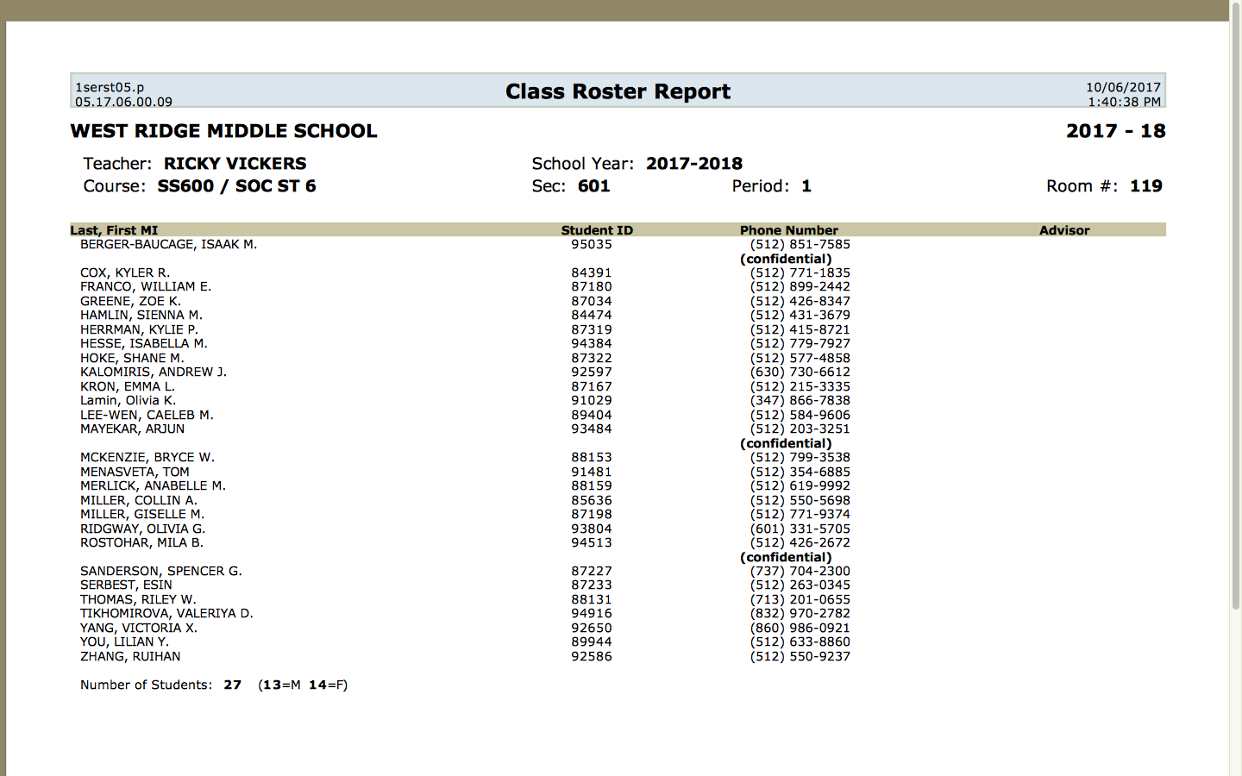
Emergency Preparedness
1. Print Your Roll
2. Run Class Roster
With Contact Info
3. Reduce the STRESS
In Emergency Situations for
You and a potential SUB!
4. We will look at how to make reports in a moment

Slide 11
Communication 101
From student Profile, you can email all his teachers at once!
Most teachers, counselors, and principals are excited to learn of this feature. Many look at the schedule or email who they think the kid has for teachers and someone is always left out!

Slide 12
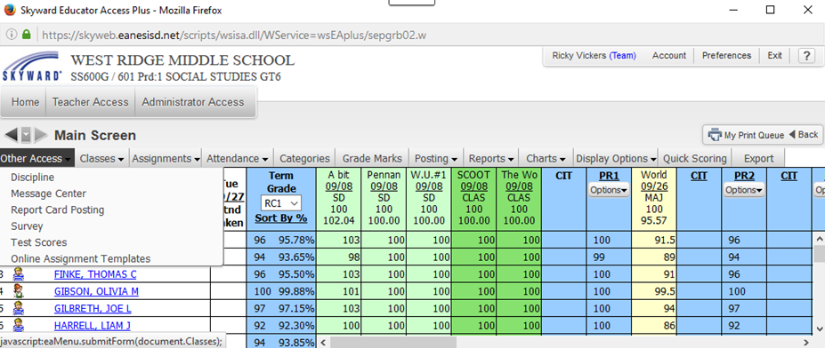
Communication!!!!!
1. Go to Other Access
2. Select Message Center

Slide 13
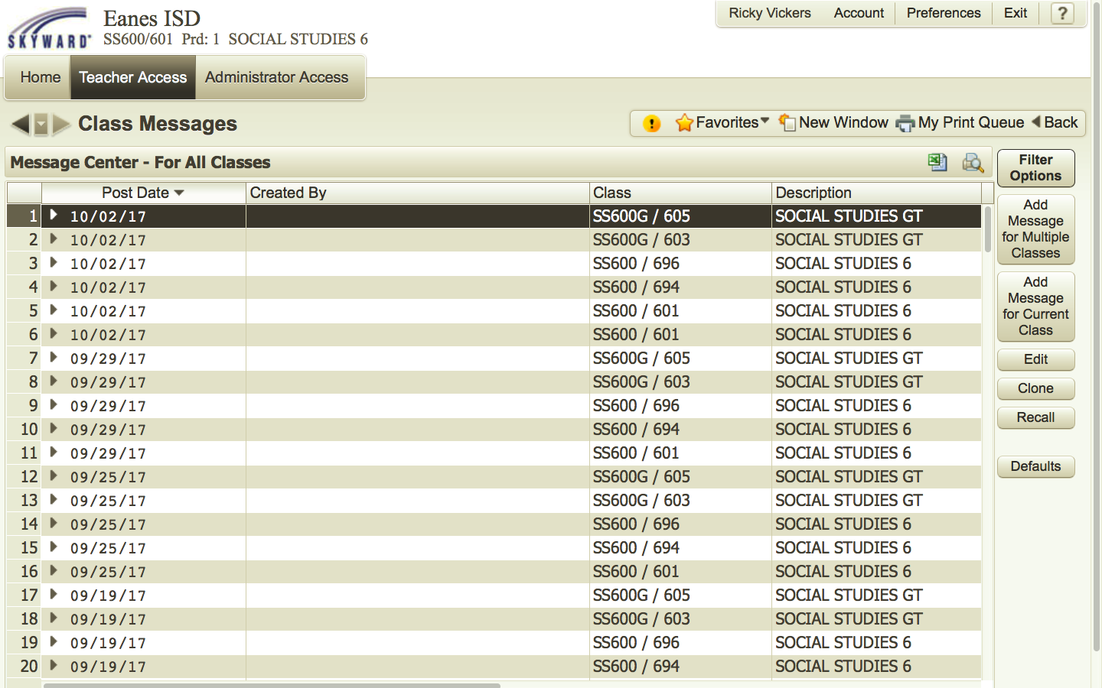
Communication!!!!!
1. Select Add Message for Current or Multiple Classes

Slide 14
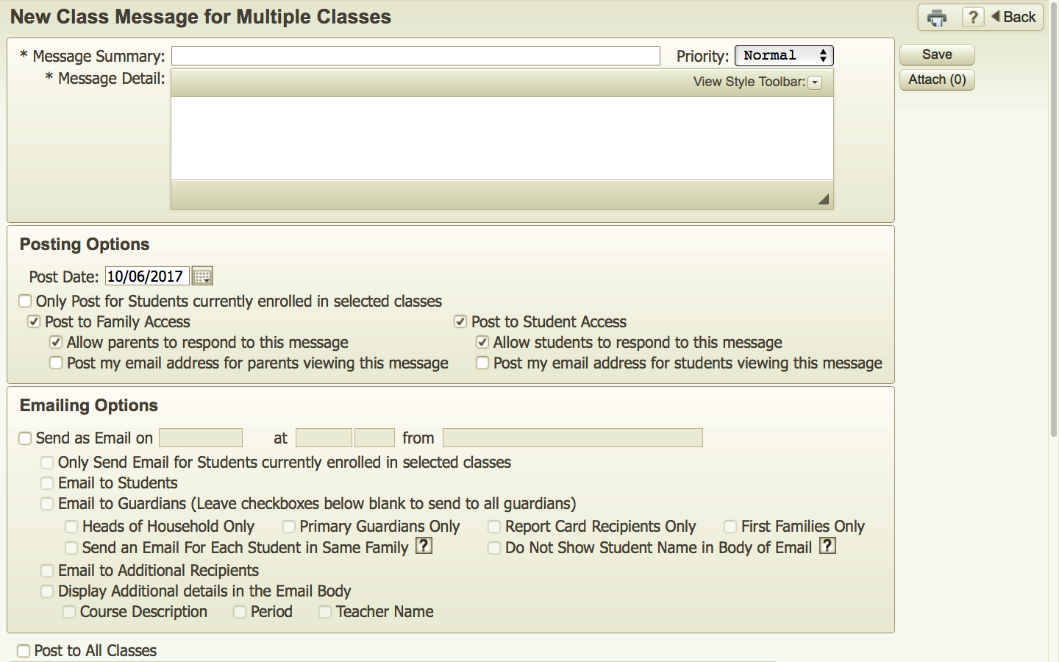
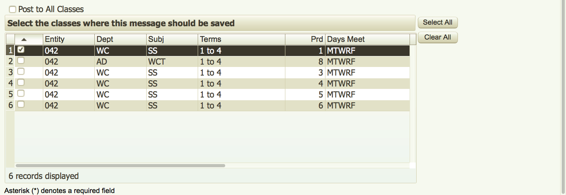
Communication!!!!!
2. Select options that
will match your purpose
3. Create Title
and Message
4. Attachment
(How to do this is on next page)
5. Email and/or Post
in Skyward
6. Include Others
7. Select Classes
8. Save

Slide 15
Communication Adding Attachments
1. After selecting Attach from previous slide this will appear
3. Locate File and select it
and it will appear here
2. Choose File
4. Upload and Save the file
5. You did it correctly when this
appears on main Message Screen

Slide 16
Communication Guidelines to Consider
Communicate Early but not too Often at the start of the school
Don’t Over Communicate
Sending Reviews and Project Directions as a “Heads Up” results in (better) student prep and happier parents (Yes, 100% happy parents is a myth)
Great way to send items to students so they have back up copies and reminders
You can send progress reports as needed

Slide 17
Online Assignments & Tests
I have an entire slideshow about
creating online assignments
2. It has many arrows as well
3. It also includes student views
4. It is located at http://wrmsrvickers.weebly.com/tsug-2017.html to download and look over.

Slide 18
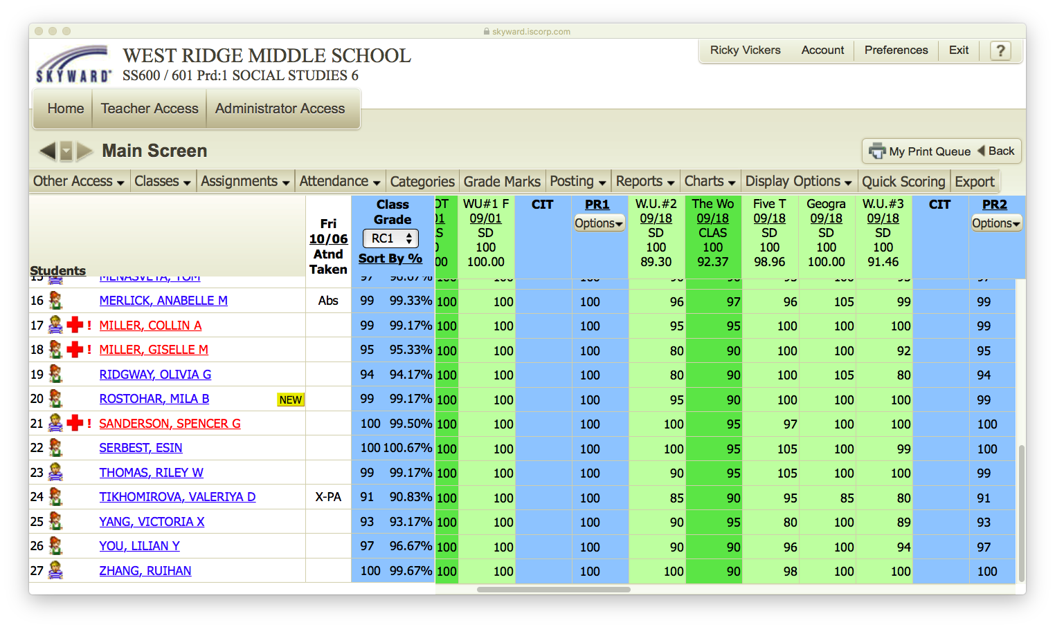
And it Also Does Grades!
Quick Scoring

Slide 19
And it Also Does Grades! Guidelines to Consider
Remind Parents it is a Snap Shot and like a selfie that is quickly deleted, it may be worthless or shameful
Explain your unique grade book rituals – how often you post, what missing means, how much detail you include
Use fewer categories if possible
I write grades on paper and search for missing items before posting
Checking too often will can more stress on you and your child – I communicate this to parents/students
I tell parents to ask their child before emailing
If you grade and post a test right away – you will always be expected to do so – stress on you
Learn to love quick scoring for late grades

Slide 20
There’s a Report for That!
1. Open Class and select Reports.

Slide 21
There’s a Report for That!
2. So Many Choices!
3. All work on the same principle
so we look at two starting
with Class Roster

Slide 22
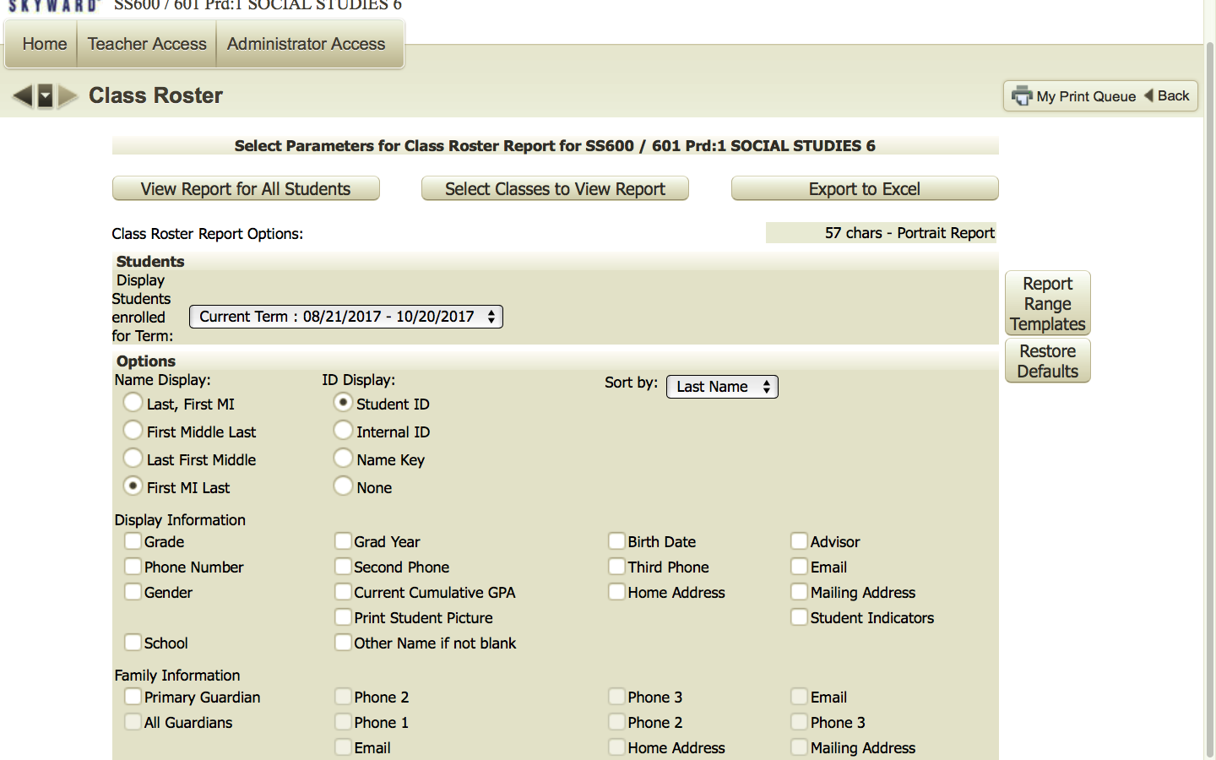
There’s a Report for That!
4. Select Class, Classes
or Student(s)!
5. Select Info for Class Roster

Slide 23
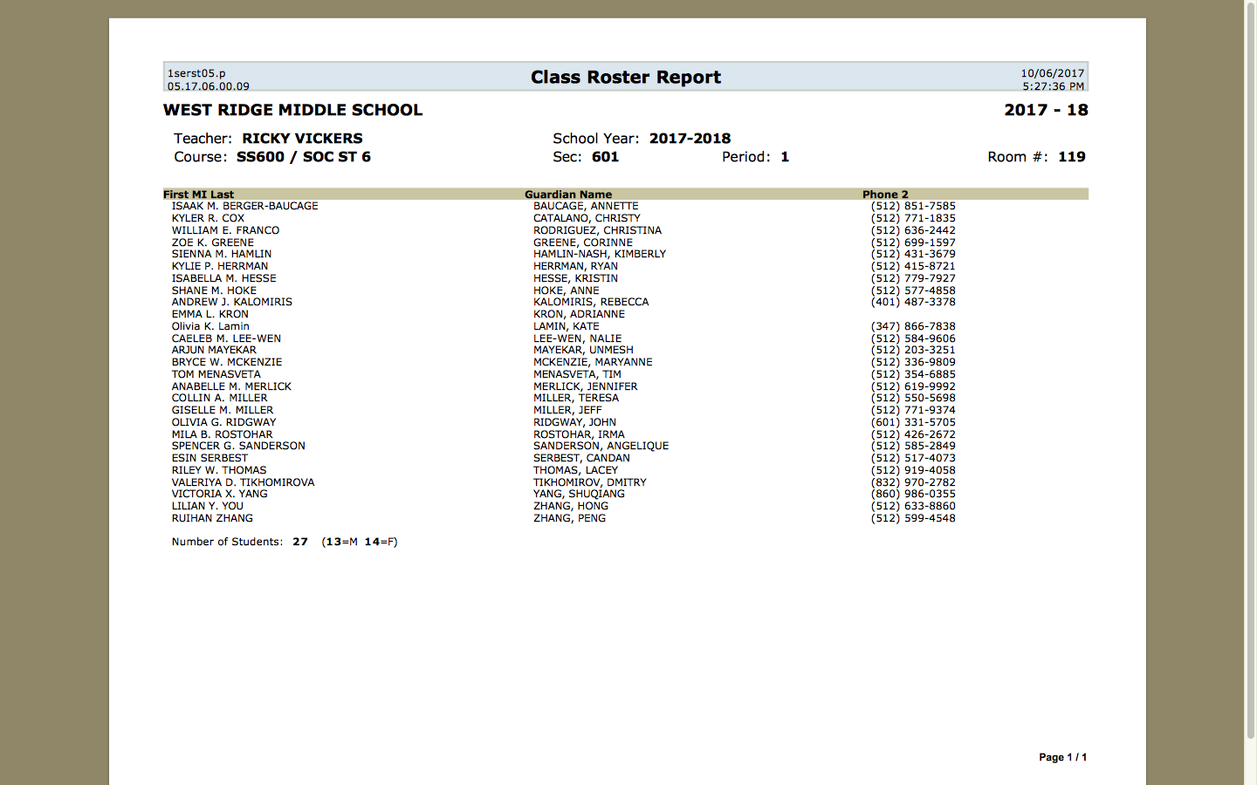
There’s a Report for That!
6. Final Report
7. Include what you need!

Slide 24
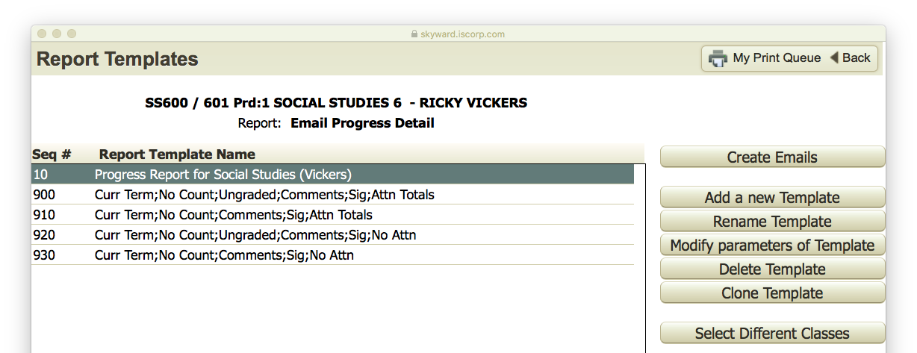
There’s a Report for That!
1. Progress Reports
2. Email Progress Reports
3. Select Report or Create a New One
4. Select Select Create Emails

Slide 25
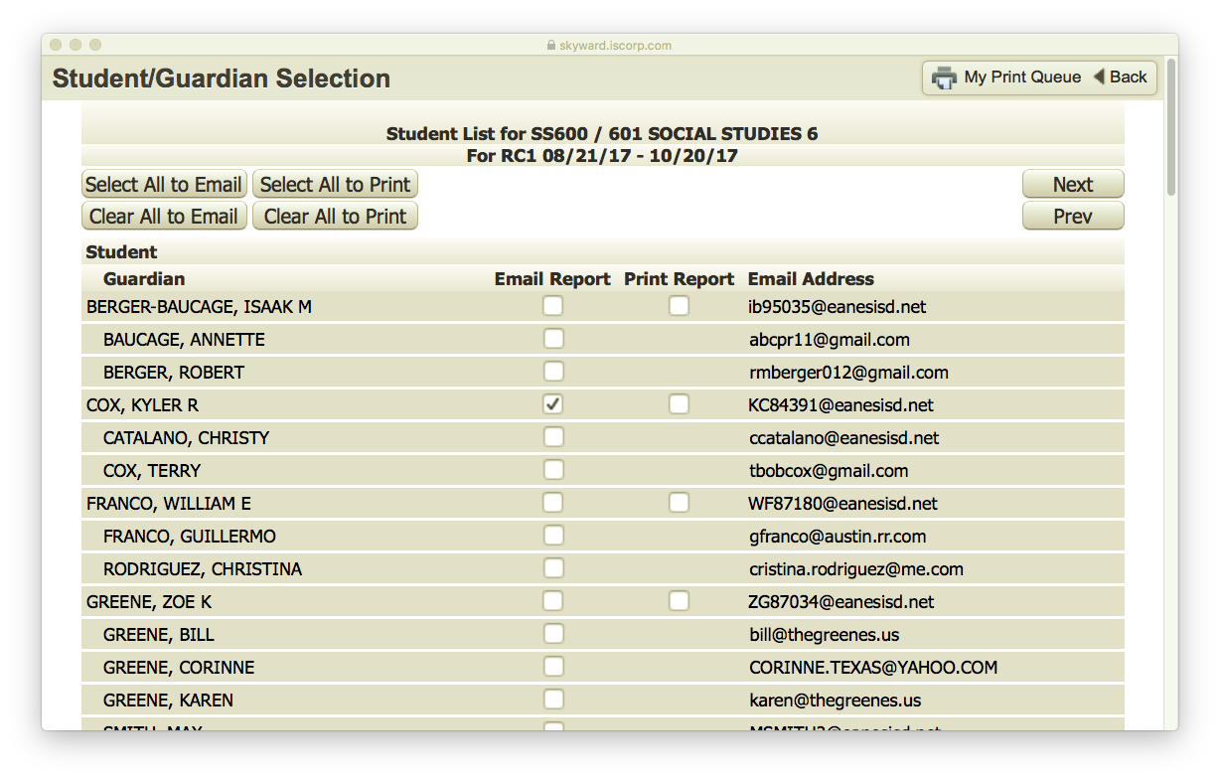
There’s a Report for That!
5. Select Recipients
6. Select Next

Slide 26
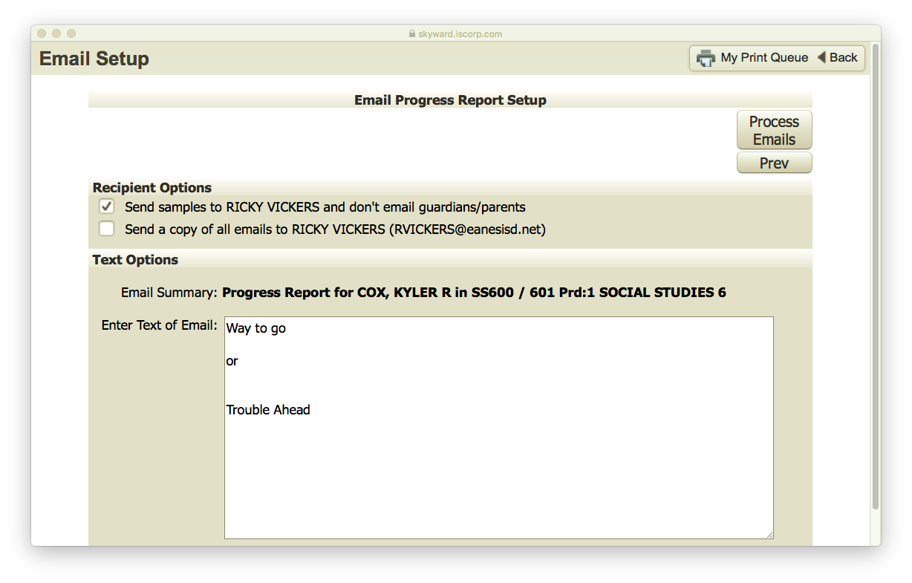
There’s a Report for That!
7. Select Recipients
9. Process Emails
8. Message of Email

Slide 27
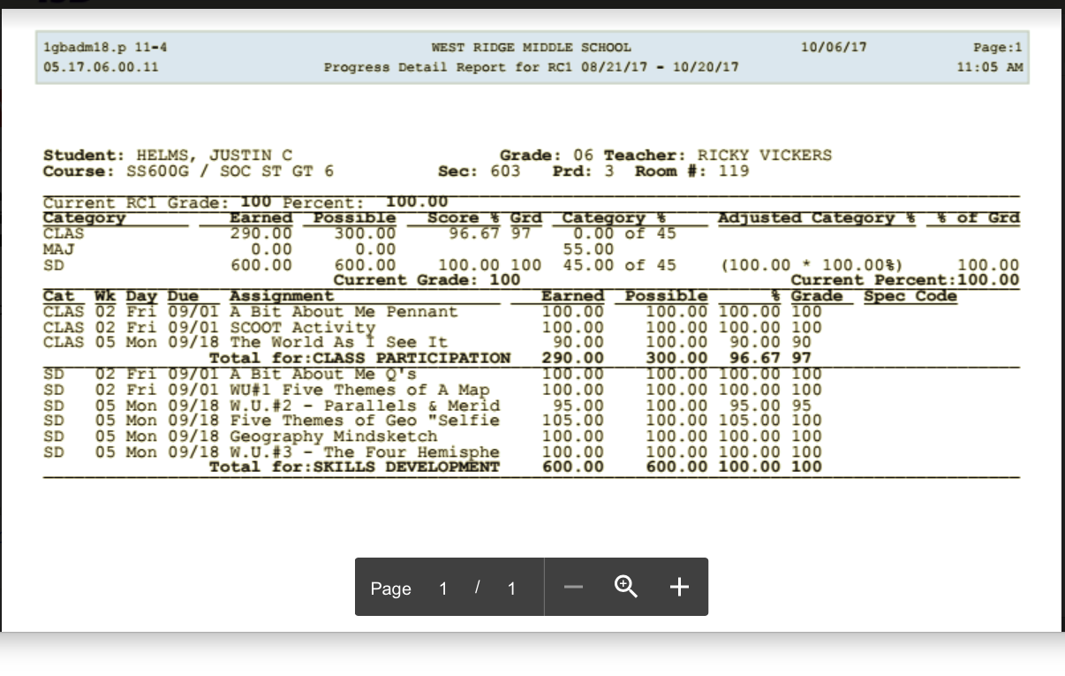
There’s a Report for That!
10. Finished Report Parent/Student Receives

Slide 28
There’s a Report for That! Guidelines to Consider
Many Types of Reports – Explore What is Useful
Some Don’t Work for My School
Sending Reports as a “Heads Up” results in greater understanding and early intervention
You can set in Templates to include only those students falling under certain benchmarks
You can still do paper and sign copies like the old days

Slide 29
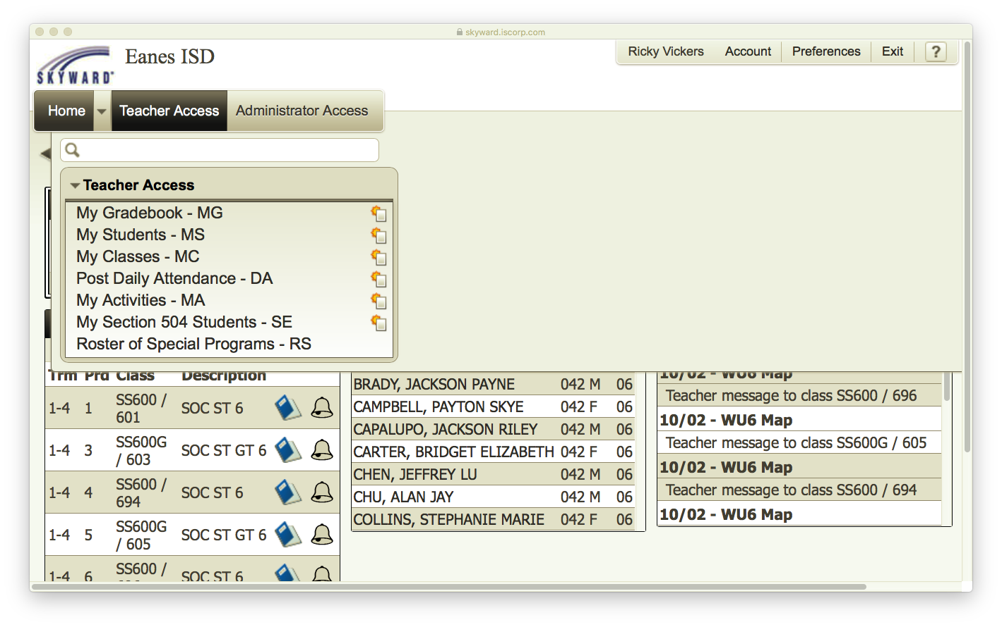
504/SPED/CYA
From Home Screen Select Teacher Access
2. Select My 504 Students

Slide 30
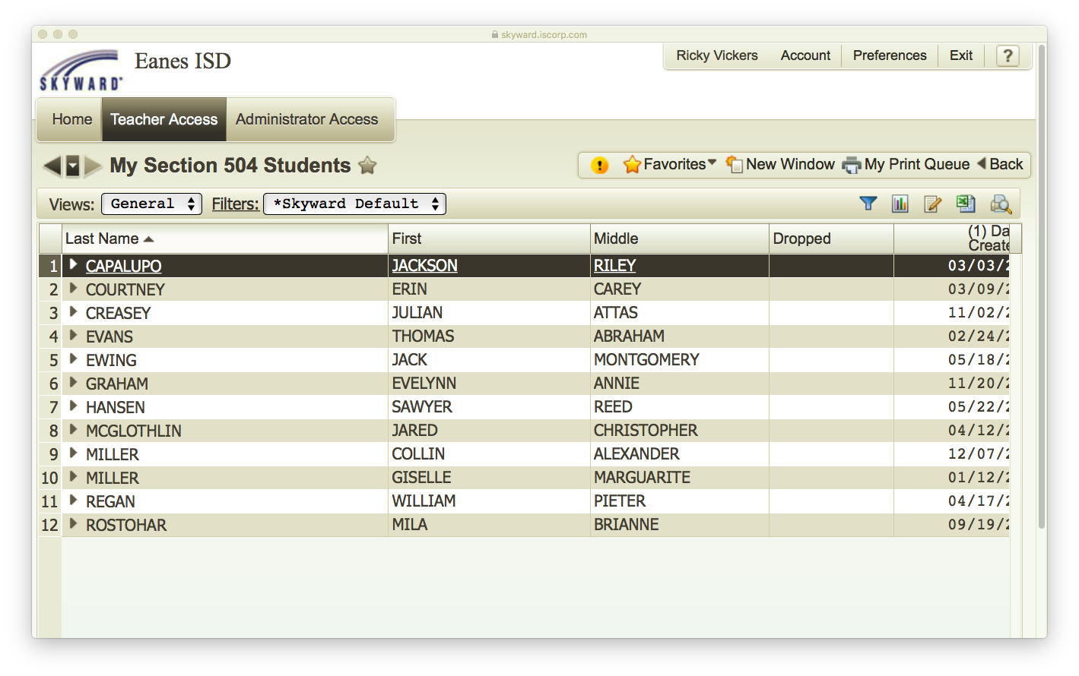
504/SPED/CYA
3. Lists my 504 Students
4. Select Arrow by name to reveal paperwork/Mods

Slide 31
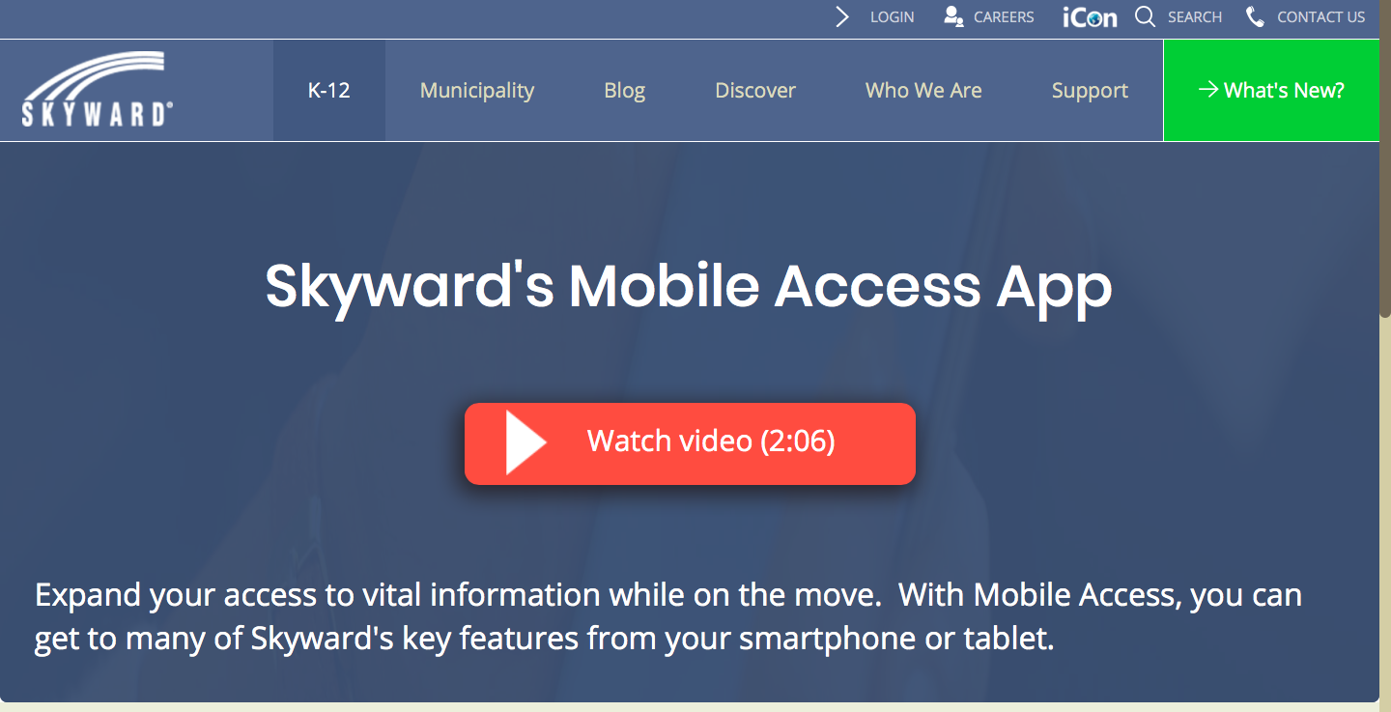
The Application –Teachers – Parents – Students!

Slide 32
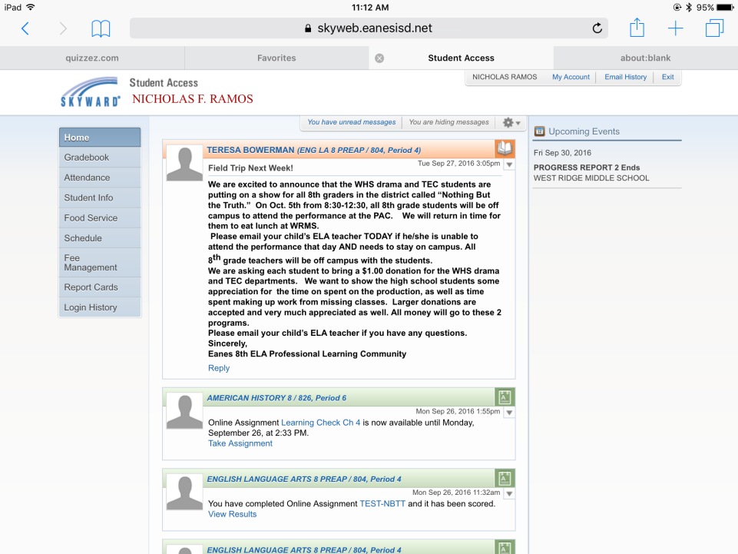
The Application –Teachers – Parents – Students!

Slide 33
The Application –Teachers – Parents – Students!
Students must complete assignments through website not the app
App keeps students in Yours - not another district’s Skyward!
Students must create their own account - not family access
App doesn't require student to use password once set-up
Easy way for students to self monitor school work
If you have fat fingers be careful when selecting in app (from Nick)
Not as user friendly or robust as website but does help in a pinch

Slide 34
Thank You! Questions?
rvickers@eanesisd.net
https://wrmsrvickers.weebly.com/tsug-2018.html

