Slide 1
2018 TSUG Conference
Gradebook Tips and Online
Assessments for the
Efficient Teacher

Slide 2
Creating an Online Assignment
1. Open a class in your gradebook.

Slide 3
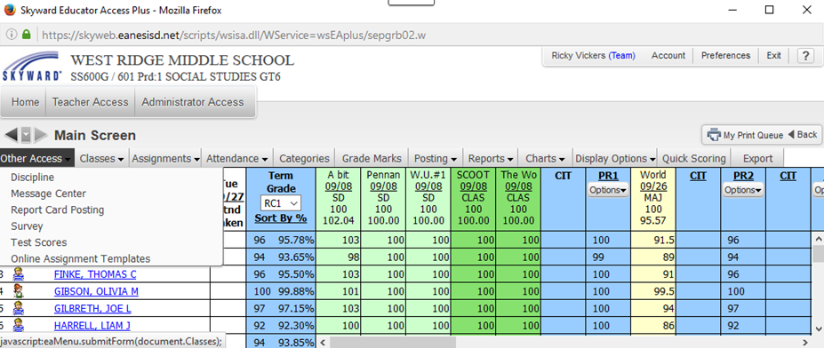
Creating an Online Assignment
2. Go to other access.
3. Select Online Assignment Templates.

Slide 4
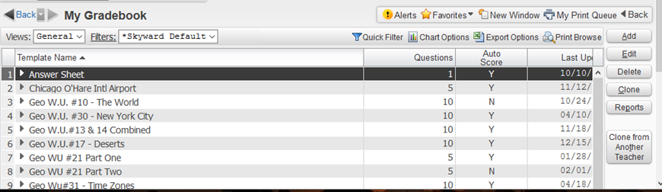
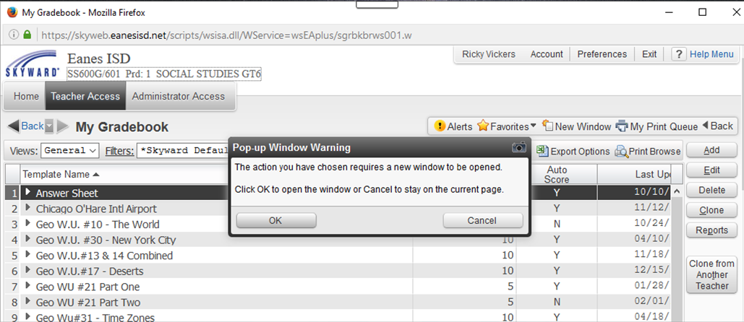
Creating an Online Assignment
TIP: I use the template so I can share assignments easily and borrow from others!
4. You can create assignments from this screen.
You can also access previously created assignments.
5. Click “Add” to create assignment and
select OK if you get any pop-up window warnings!

Slide 5
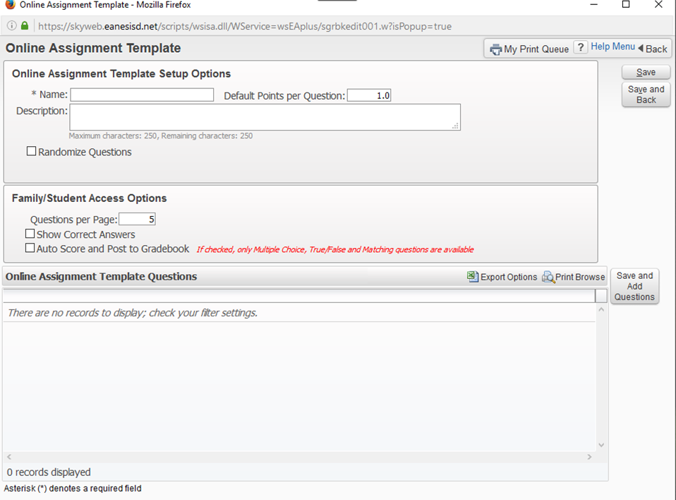
Creating an Online Assignment
TIP: Randomize questions and use fewer questions per page
to make it more difficult to cheat.
6. Begin filling in the Online Assignment Template:
7. Name of assignment
8. Points
Per
Question
9. Description
11. Save Here to begin!
10. Auto Score to Gradebook

Slide 6
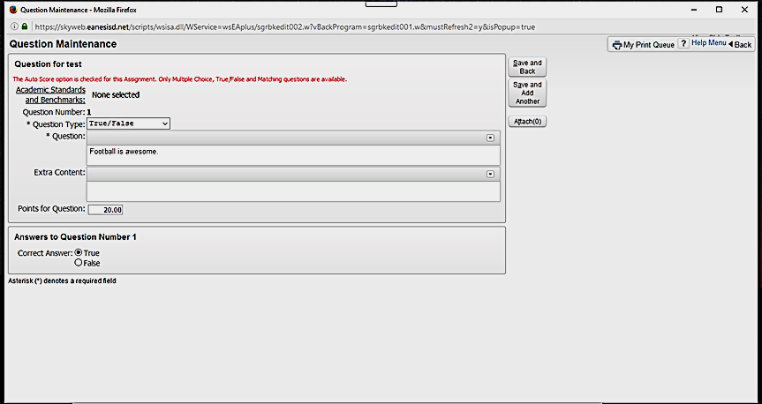
Creating an Online Assignment
TIP: Only change points to “weight” a question. Be sure it adds up to 100!
12. Choose question type.
13. Enter Question
16. Save
and continue
14. Modify Points if desired
15. Designate Answer

Slide 7
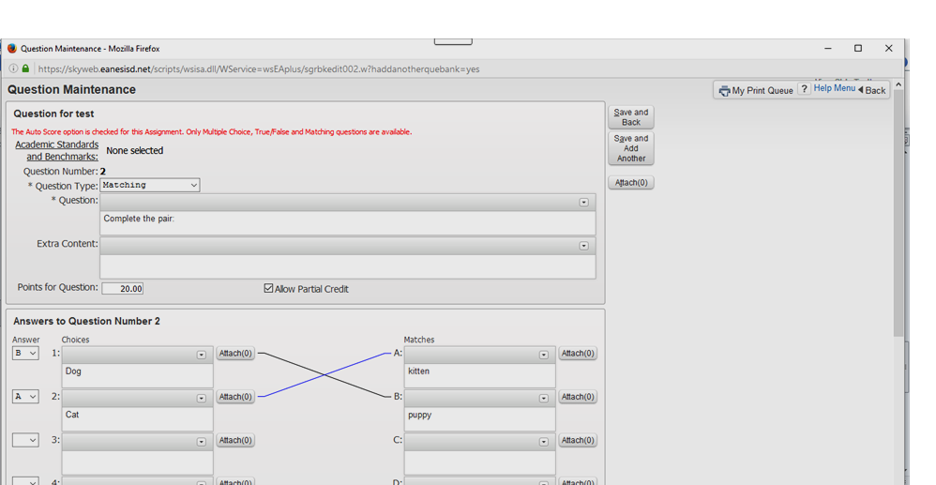
Creating an Online Assignment
TIP: Be sure to give partial credit to matching questions.
17. Choose question type.
18. Enter Question
or
directions
21. Save and continue
Or save and back when
done
19. Modify Points if desired
20. Designate Answer

Slide 8
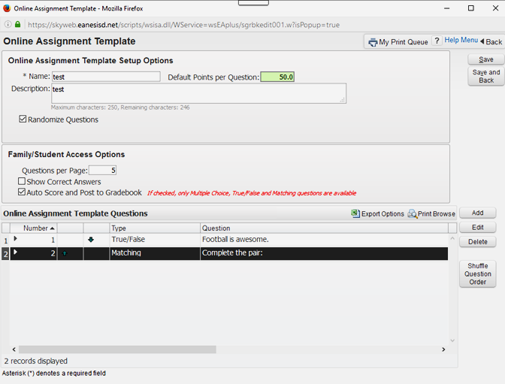
Creating an Online Assignment
TIP: Don’t be afraid to check show correct answers as that can
be controlled when assigned to the class.
22. A completed test template looks like:
23. Name
25. Save when
done
24. Modify
if
desired
26. Quickly edit/add questions now or next year!

Slide 9
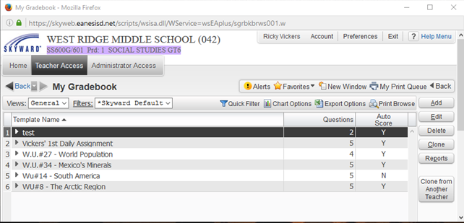
Creating an Online Assignment
TIP: Assignments are listed alphabetically so use helpful titles as the list does grow!
27. Your new assignment/test is now listed:
28. Now return to gradebook and go to add assignment.

Slide 10
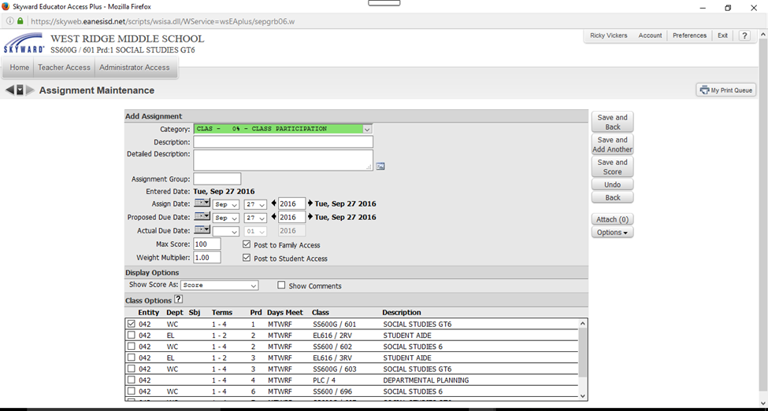
Creating an Online Assignment
TIP: Remember when adding an online assignment to the gradebook
that there are a few extra steps involved then just recording grades!
29. Click on Add Assignment to open the following box:

Slide 11
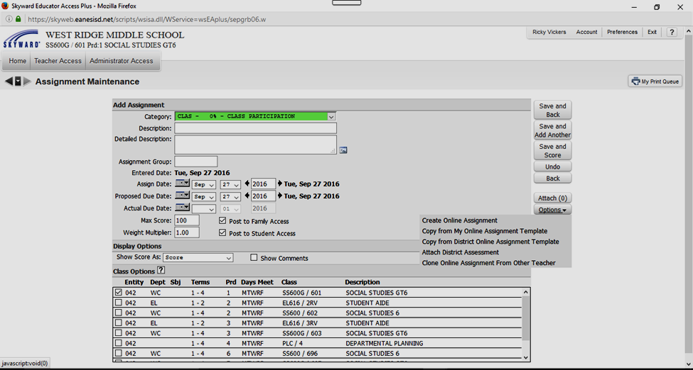
Creating an Online Assignment
TIP: Keep chocolate nearby to help when doing this for the first time.
30. Click on options
31. Click on Copy from my Online Assignment Template

Slide 12
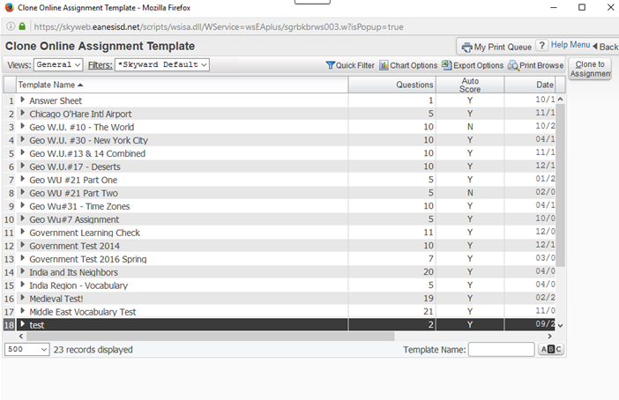
Creating an Online Assignment
TIP: You can search for a template if you can’t locate it.
32. Locate and click on Assignment/Test
33. Choose Clone to Assignment

Slide 13
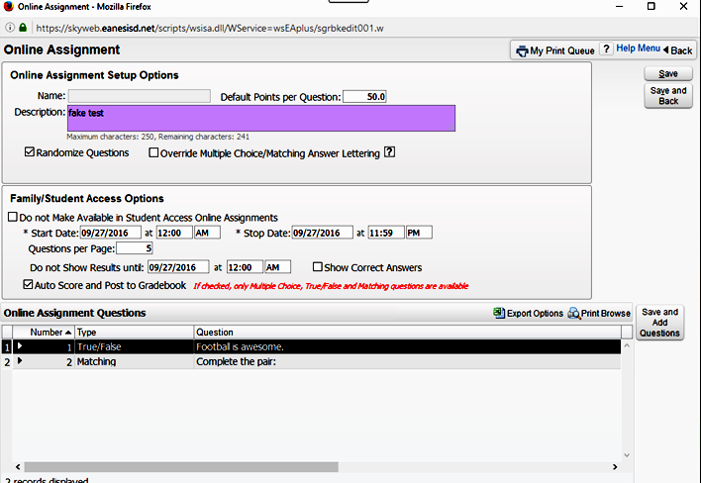
Creating an Online Assignment
TIP: The name box doesn’t work on this page and give yourself a window before answers appear for students who are sick!
34. Add description
35. Add start/stop dates
37. Save and back
when Done
36. Choose when answer might appear!

Slide 14
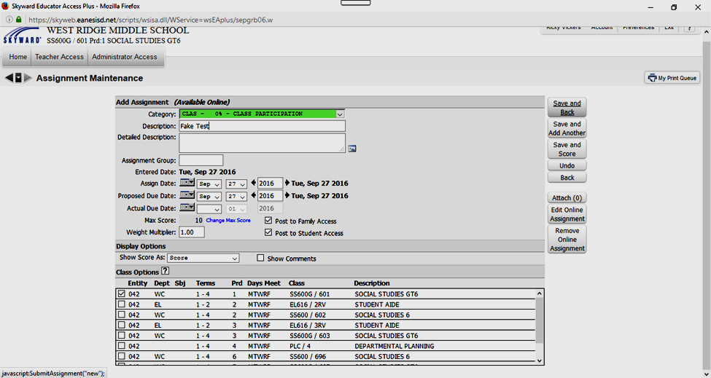
Creating an Online Assignment
TIP: If you see (Available Online) then you have done everything correct
thus far and are on the home stretch!
38. Fill Assignment Info as you would any other assignment:
39. Name/Type
of Assignment
40. Assign Classes
41. Save and Back

Slide 15
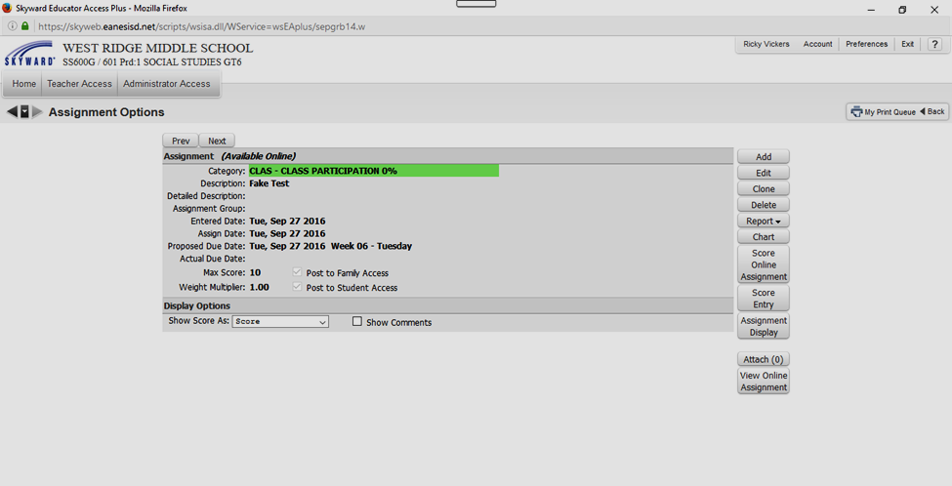
Creating an Online Assignment
TIP: If you still see (Available Online) then you are done!
42. The assignment/test is now ready for students!
43. Gradebook View

Slide 16
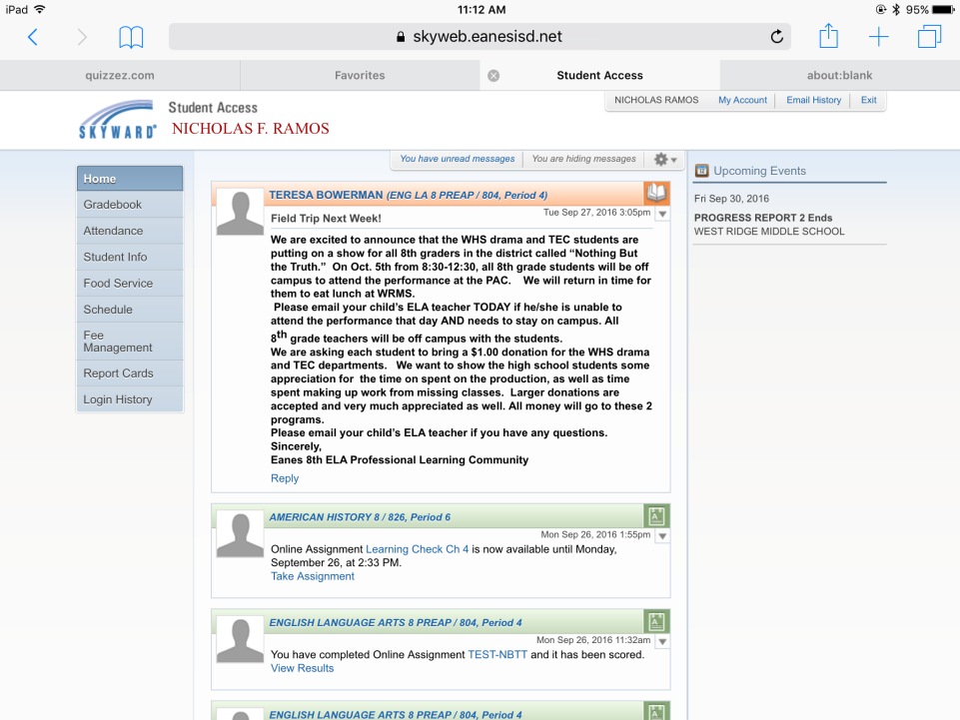
Creating an Online Assignment
TIP: Make sure students log on through your districts website!
44. The students should click on the assignment
link embedded on their dashboard!

Slide 17
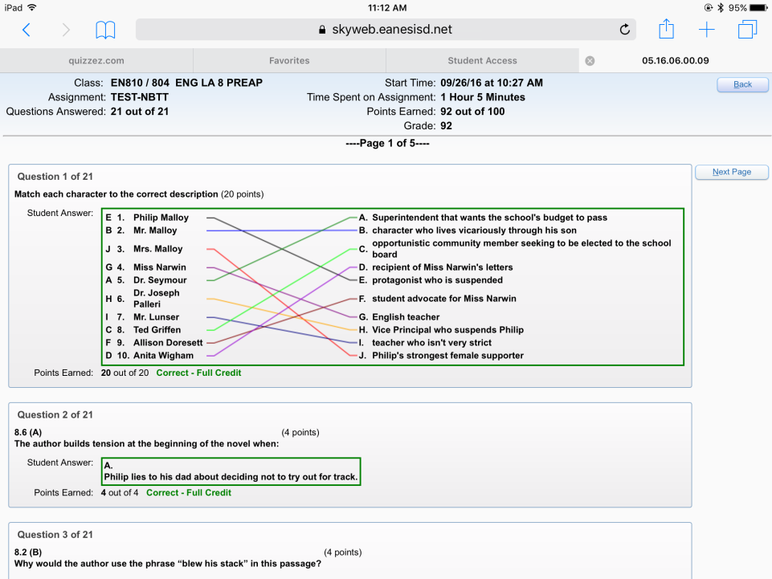
Creating an Online Assignment
TIP: Nick wanted you to know that there was an 8 point curve!
45. A finished test from a student’s point of view:

Slide 18
Online Test Security
Many teachers worry about
online test security!
Quick Tips:
1. There a few options to lock in students to the site.
2. Set times to correspond with class periods in test setup.
3. Upload during passing period.
4. Randomize test questions when possible.

Slide 19
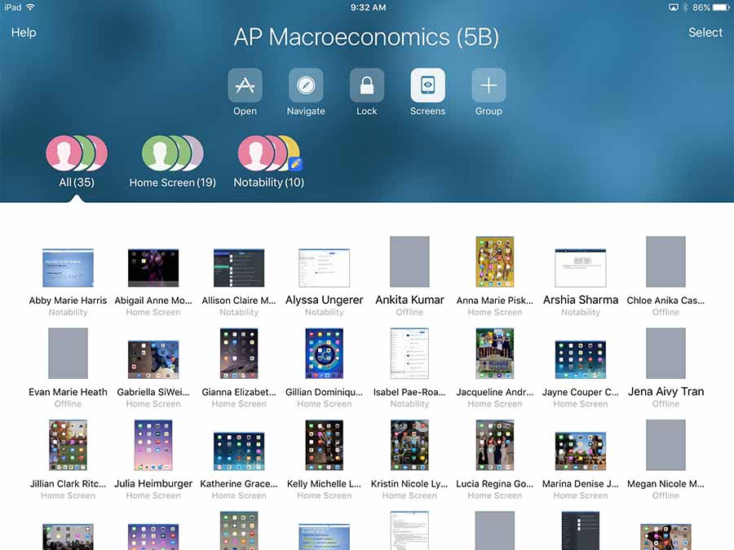
Nearpod or Apple Classroom
Both platforms allow you to see the screens of the students.
Pros:
You see the students live
Both Apps are free
Cons:
Apple Classroom works on iPads
Testing Sped; 504
They will find a way!

Slide 20
Creating an Online Assignment
TIPS GALORE!
Students should open Skyward through your school website not the app
Remind students to use your school’s link not another district’s Skyward
Students must create their own account - not family access
Click on forgot password to begin student password set-up
It is easy to change a student password
Be sure to practice with a simple assignment before doing a test
If you have fat fingers be careful when selecting answers (from Nick)
Be aware students can save and submit or save and continue later
Monitor by refreshing your skyward page to see who is done
You can secure the test through Nearpod or Apple Classroom

Slide 21
Creating Online Efficiency
FINAL TIPS GALORE!
Use the Message Center to keep parents informed – don’t over inform!
I record grades on paper before entering into Skyward – fewer emails!
You can email a student’s classroom teacher from their info page.
Explain your Skyward tendencies to your parents
How often to look for grades?
Can they still improve on online tests?
What do missing or empty grades mean?
Remind them often that averages are a digital snapshot.
No surprises – message center is your friend!

Slide 22
Thank You! Questions?
rvickers@eanesisd.net
https://wrmsrvickers.weebly.com/tsug-2018.html

